Slide 1

Speech enhancement using deep learning supervised by : prof.dr.enas farouk

Slide 2
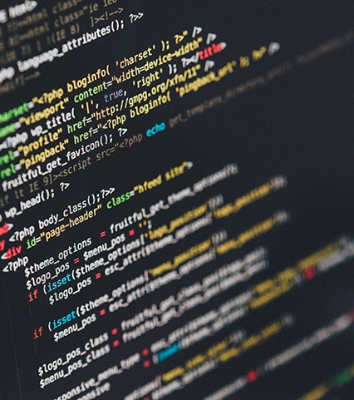
Presented by :
1-Abdelrhman Hussein Ahmed
2-Mazen Mostafa Ahmed
3-Zeyad Mohamed Fouad
4-Zeyad Hany Mohamed
5-Fouad Saleh Sobhy
6-Mahmoud Mazen
7- Amr Mohamed Mahmoud

Slide 3
Introduction
Background
Related Work For Speech Denoising
Speech Enhancement Using Deep Learning
Algorithms
Implementation , Results and Discussion
Conclusion & Future Works
References

Slide 4
Introduction

Slide 5
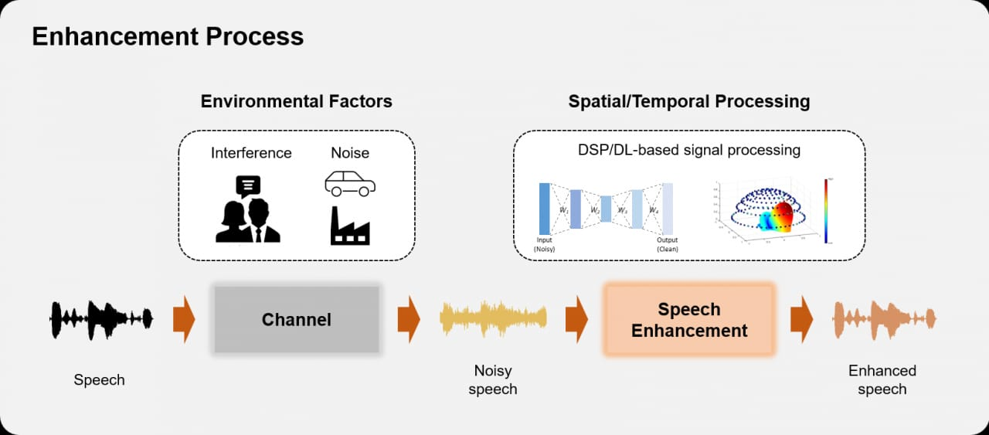
Introduction to Speech Enhancement
- definition of speech enhancement:
The process of improving the quality and intelligibility of speech signals that have been degraded by various factors, such as background noise, reverberation, or distortion.
Common challenges in speech enhancement:
Diverse noise and distortion types Non-stationarity of noise and speech signals Preserving the natural characteristics of speech while reducing noise

Slide 6
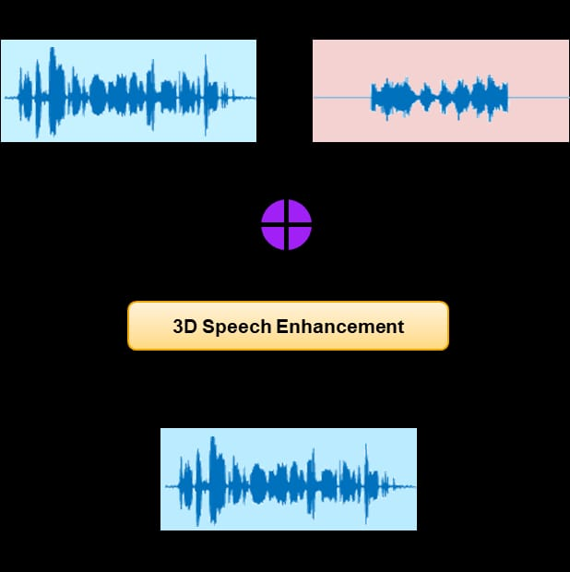
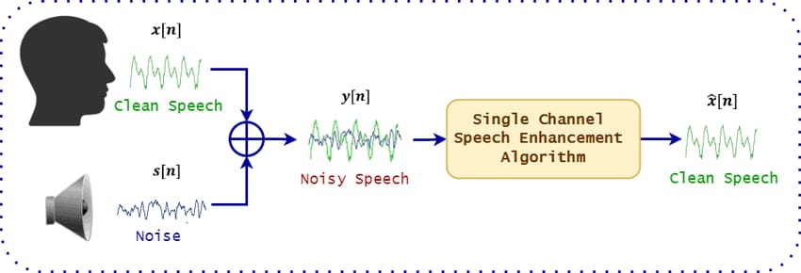
Introduction to Speech Enhancement (cont.)
Importance of speech enhancement:
- Improves communication quality in various applications (e.g., telephony, video conferencing, hearing aids) - Enhances the performance of downstream speech processing tasks (e.g., automatic speech recognition, speaker identification) - Enables better user experience and accessibility for people with hearing impairments

Slide 7
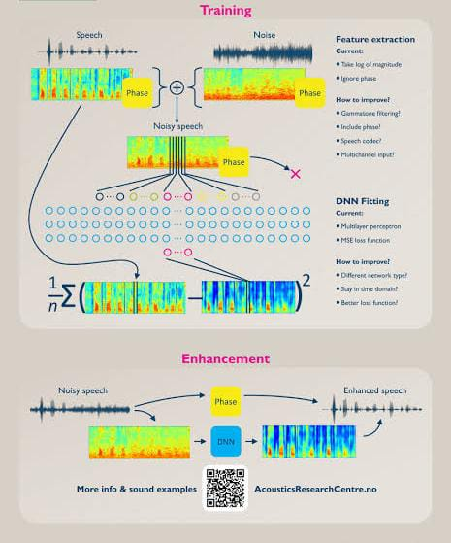
- Introduction to deep learning for speech enhancement:
- Advantages of deep learning compared to traditional signal processing approaches - Ability to learn complex non-linear mappings between noisy and clean speech
Deep learning architectures for speech enhancement:
-Convolutional neural networks (CNNs)
- Recurrent neural networks (RNNs), including Long Short
-Term Memory (LSTMs) -

Slide 8
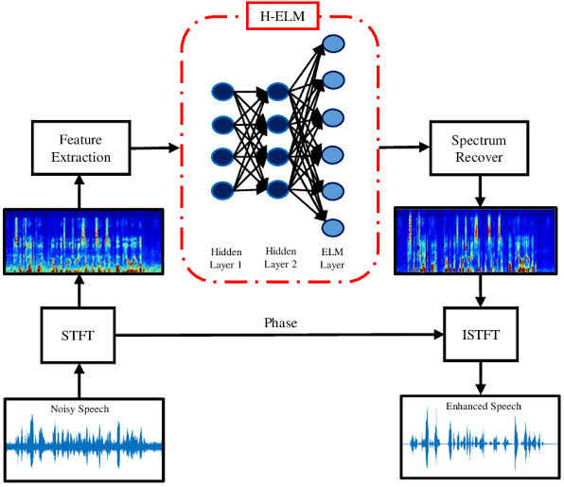
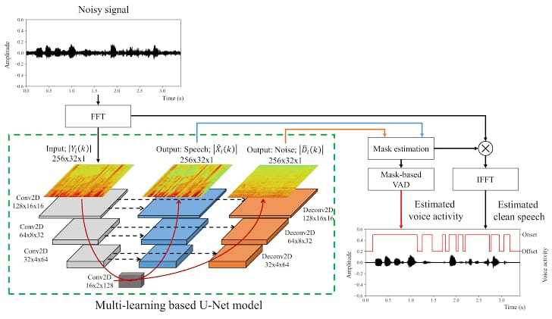
Introduction (cont.)
Key deep learning techniques:
- Time-frequency representation learning (e.g., using spectrograms)
Multi-channel processing (e.g., using microphone arrays)
Unsupervised and semi-supervised learning
Evaluation metrics for speech enhancement:
- Objective measures (e.g., Signal-to-Noise Ratio, Perceptual Evaluation of Speech Quality) - Subjective listening tests

Slide 9
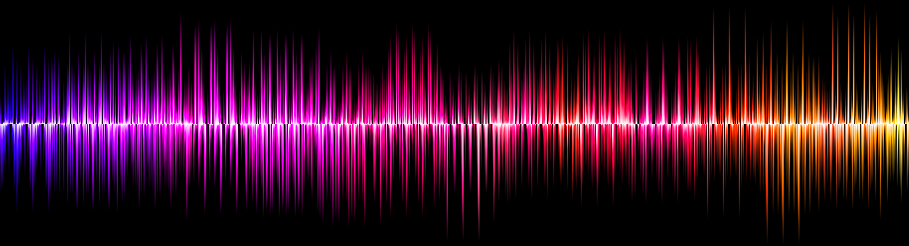
Background Speech Enhancement

Slide 10
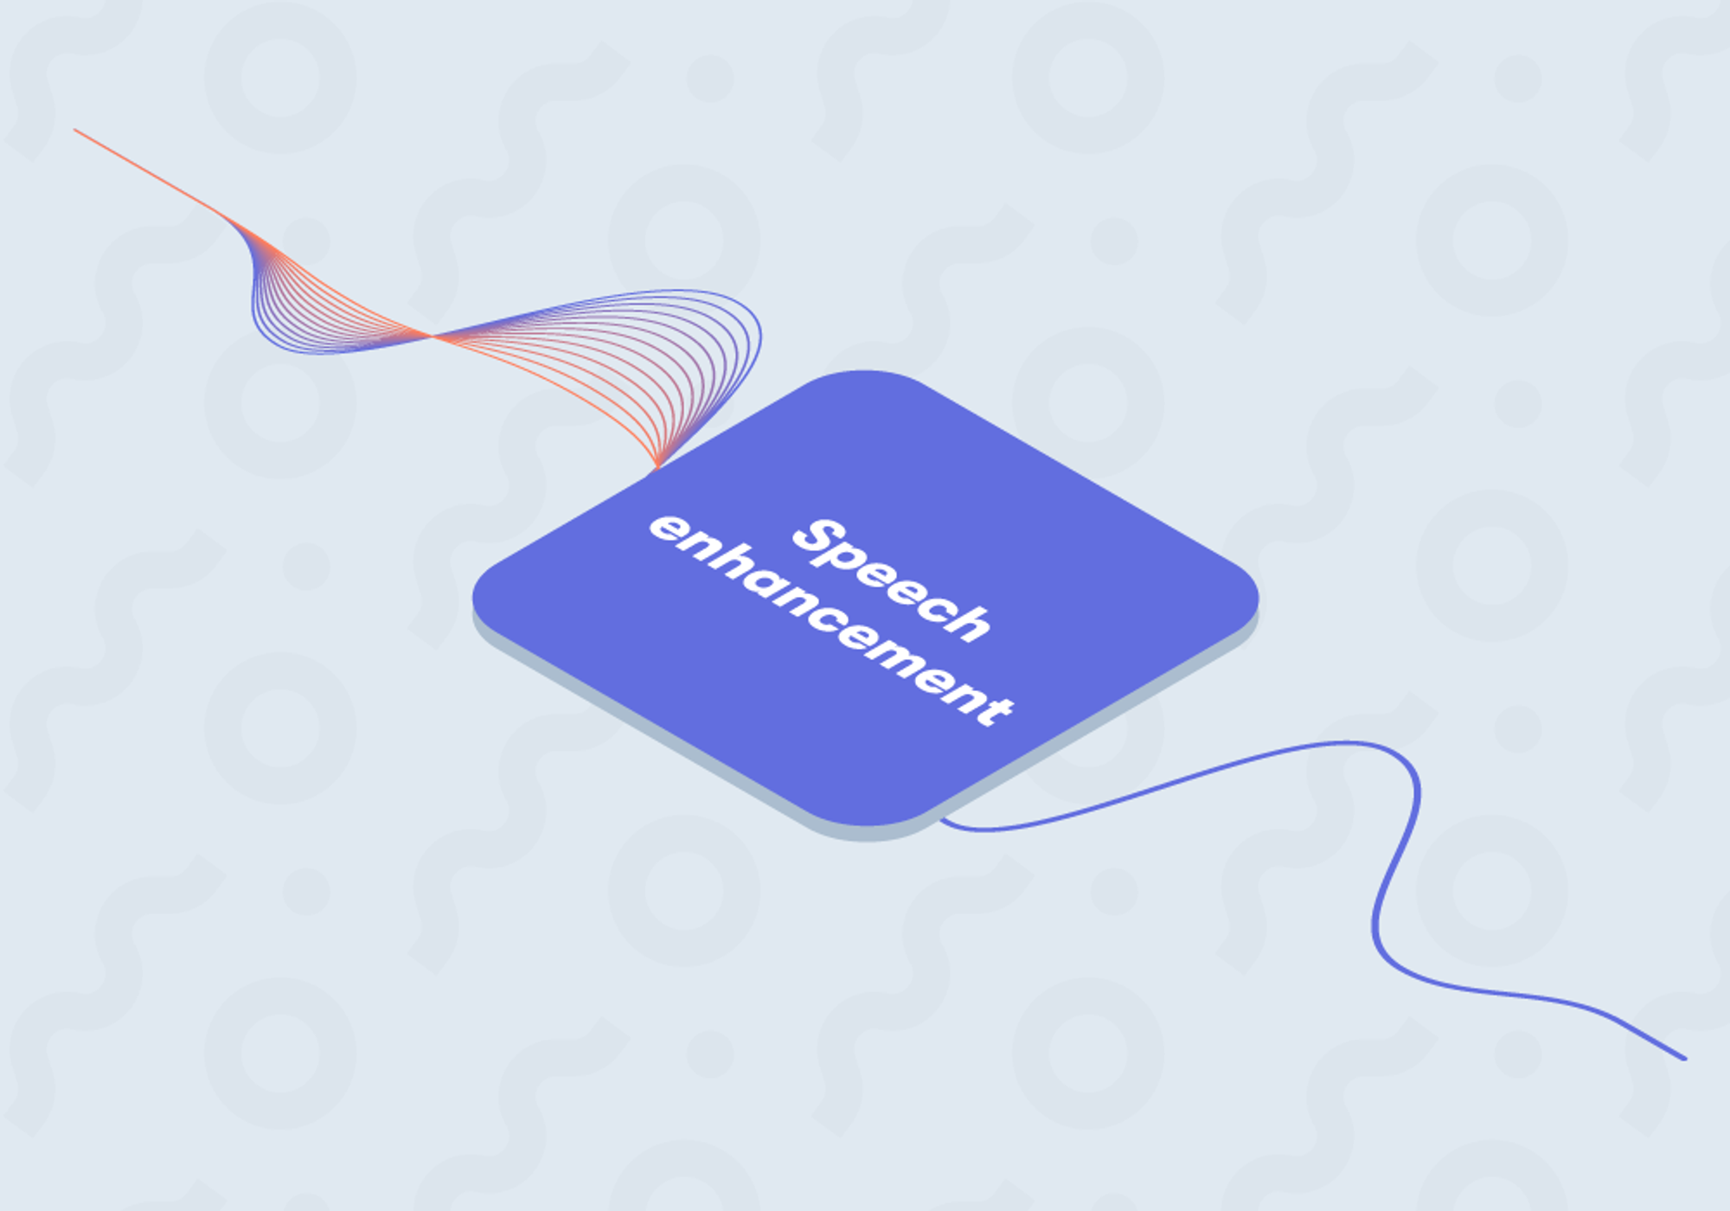
Background Speech Enhancement is a topic in the field of audio signal processing that aims to improve the quality and Clarity of speech signals that are contaminated by various types of background noise.
In many real-world scenarios, such as telephone conversations, voice recordings, or video conferences, the presence of background noise can degrade the quality and comprehensibility of the desired speech signal.

Slide 11
Background
Spectral Subtraction: is a method for restoration of the power spectrum of a signal observed in additive noise
Wiener Filtering: This technique applies a Wiener filter that suppresses the background noise while preserving the desired speech signal.
Statistical Model-Based Methods:
Statistical model-based approaches, have been employed to estimate the clean speech signal by modeling the statistical properties of speech and noise.

Slide 12
Related Work For Speech Denoising

Slide 13
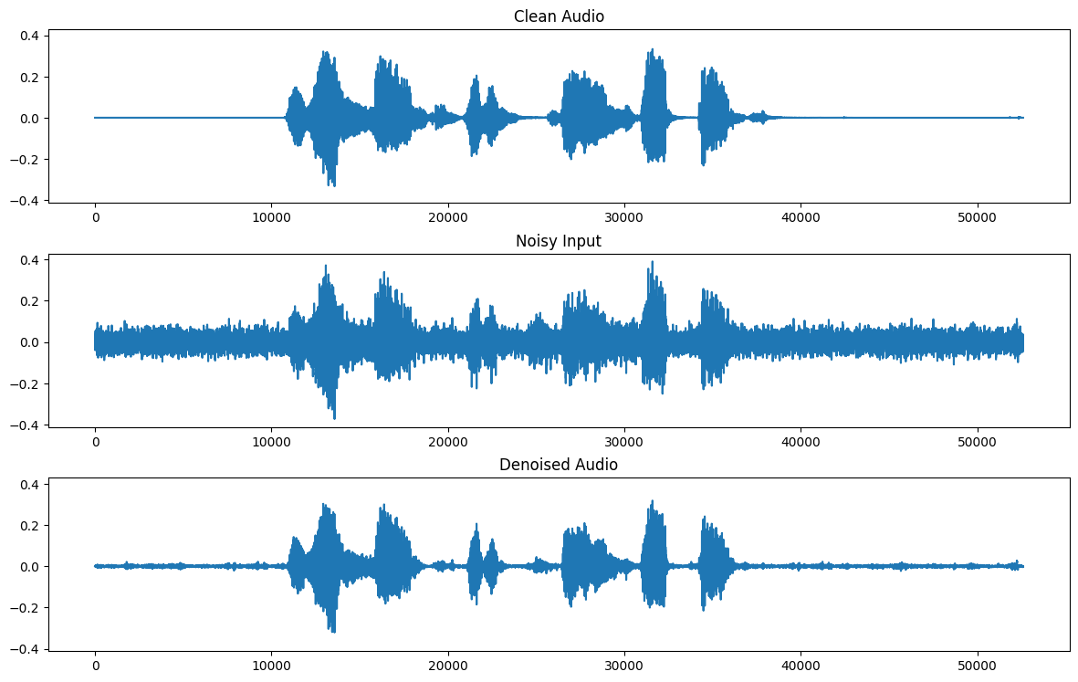
Introduction to Speech Denoising
What is Speech Denoising?
It's the process of removing unwanted noise from speech signals while preserving speech quality.
Example:
Imagine a scenario where you are trying to have a conversation in a noisy restaurant. Speech denoising helps remove the background noise, making the speech clearer and easier to understand.
Why is it Important?:
Vital for improving speech communication in noisy environments.

Slide 14
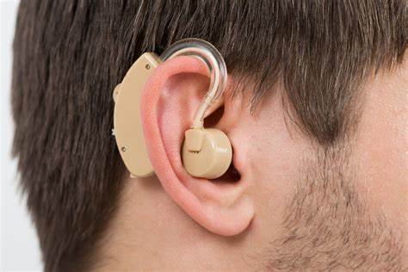

Applications of Speech Denoising
Speech denoising is crucial in various applications such as telecommunication, hearing aids, voice assistants, etc.
Example:
In telecommunication, speech denoising ensures clear communication during phone calls or video conferences, even in noisy environments.

Slide 15
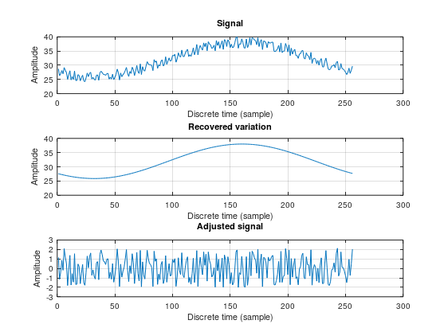
Traditional Approaches to Speech Denoising
Traditional methods for speech denoising include spectral subtraction, Wiener filtering, and adaptive filtering.
Example:
Spectral subtraction involves estimating the noise spectrum and subtracting it from the noisy speech spectrum to obtain a cleaner speech signal.
Advantages:
Simple implementation, computationally efficient.

Slide 16

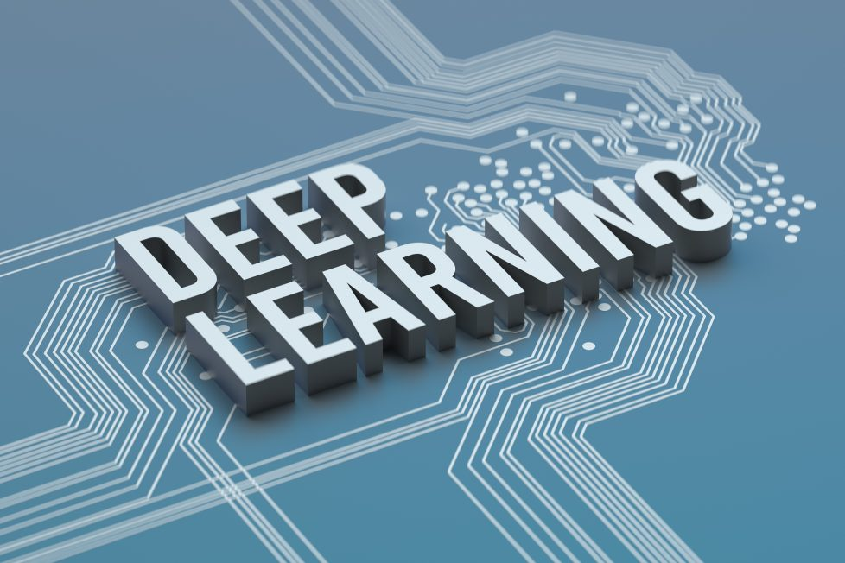
Machine Learning Approaches
Machine learning techniques have revolutionized speech denoising by capturing complex speech patterns and noise characteristics.
Example:
Deep learning models, such as neural networks, can learn the mapping between noisy and clean speech signals, resulting in enhanced speech quality.

Slide 17
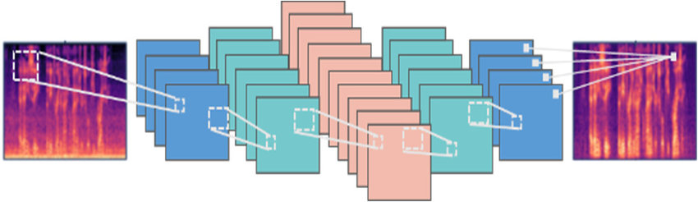
Deep Learning for Speech Denoising
Techniques:
Deep Learning (CNNs, RNNs), Supervised, Unsupervised, Semi-supervised learning.
Example:
CNNs can learn to extract meaningful features from the spectrogram of the noisy speech signal, enabling effective denoising.

Slide 18
Speech Enhancement Using Deep Learning

Slide 19

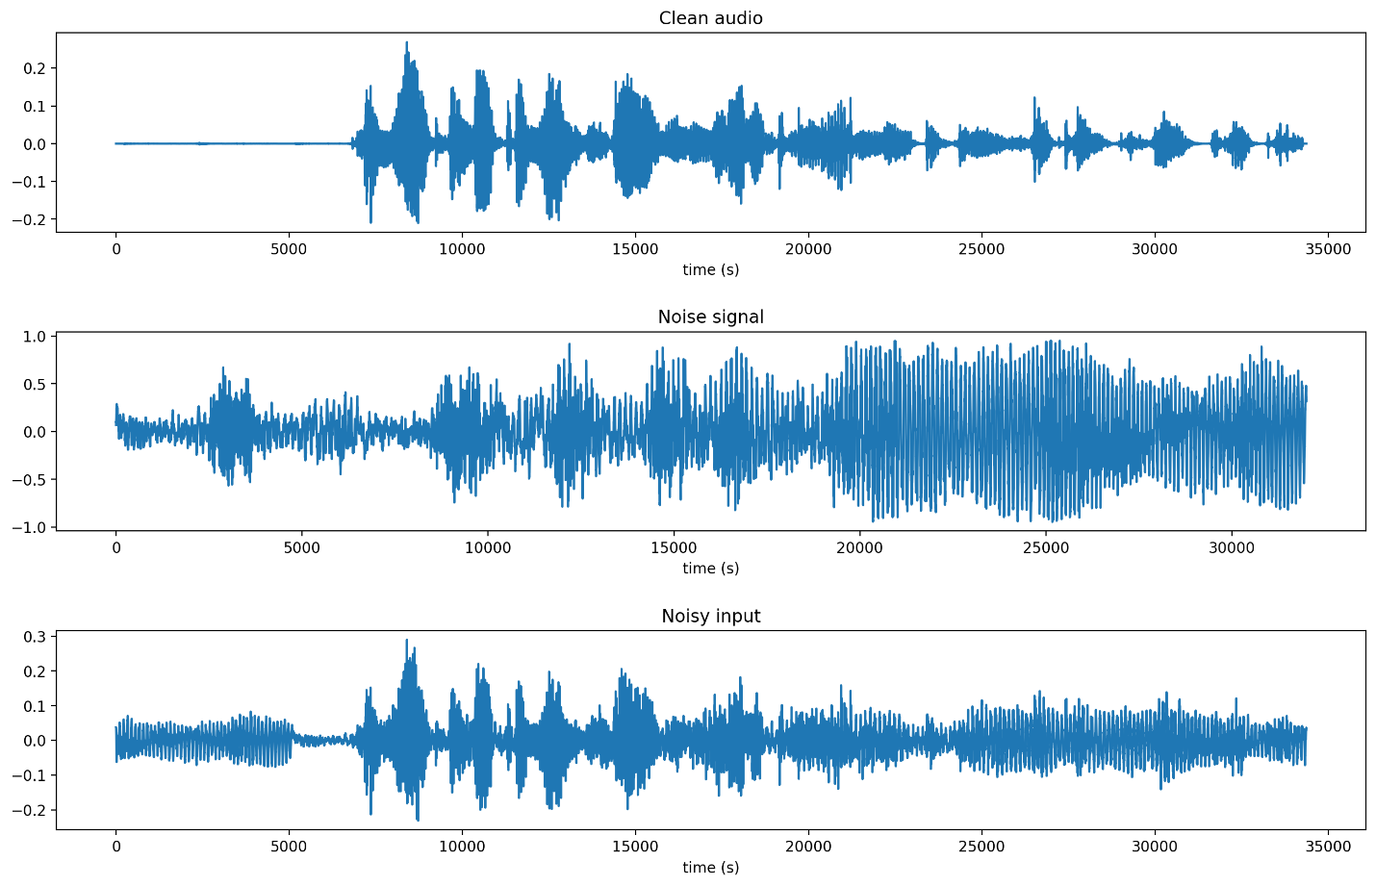
Speech Enhancement with Deep Learning:
In today's world, clear communication is essential. But background noise can significantly hinder our ability to understand each other. This presentation explores how Deep Learning, a form of Artificial Intelligence, is revolutionizing the field of speech enhancement. We will delve into the challenges of noisy speech, the power of Deep Learning, and how it is used to create cleaner, clearer conversations.
Identify the specific task you want to solve with audio data, such as speech recognition, music classification, sound event detection.
Preprocess the audio data by converting it to a suitable format.
Example:

Slide 20

The Problem: Noisy Speech
Background noise pollutes speech signals
Traffic noise, machinery hum, and babble can significantly reduce intelligibility
Traditional signal processing methods struggle with complex noise environments
Imagine trying to have a conversation on a busy street corner. The constant roar of traffic, sirens, and people talking makes it difficult to understand what the other person is saying. This is the challenge of noisy speech. Background noise corrupts the clean speech signal, making it hard to hear and understand. Traditional methods for noise reduction, while helpful, often struggle with complex and dynamic noise environments.
Evaluate the trained model on a test set to assess its performance and Fine-tune the model or adjust hyperparameters based on performance metrics.
Keep up with the latest research and developments in the field of audio processing and deep learning and Pre-trained models on large audio datasets can provide a good starting point and save training time.

Slide 21
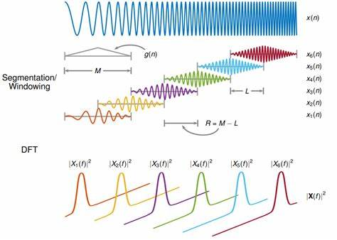
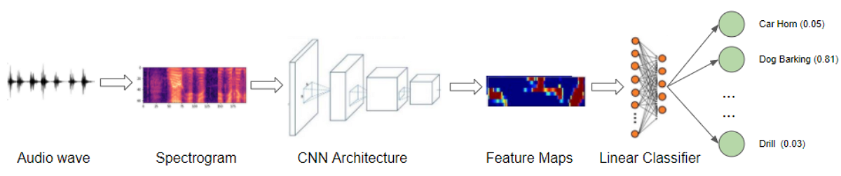
Examble The use of deep learning in noise isolation, sound improvement and distinguishing difference in sounds:

Slide 22
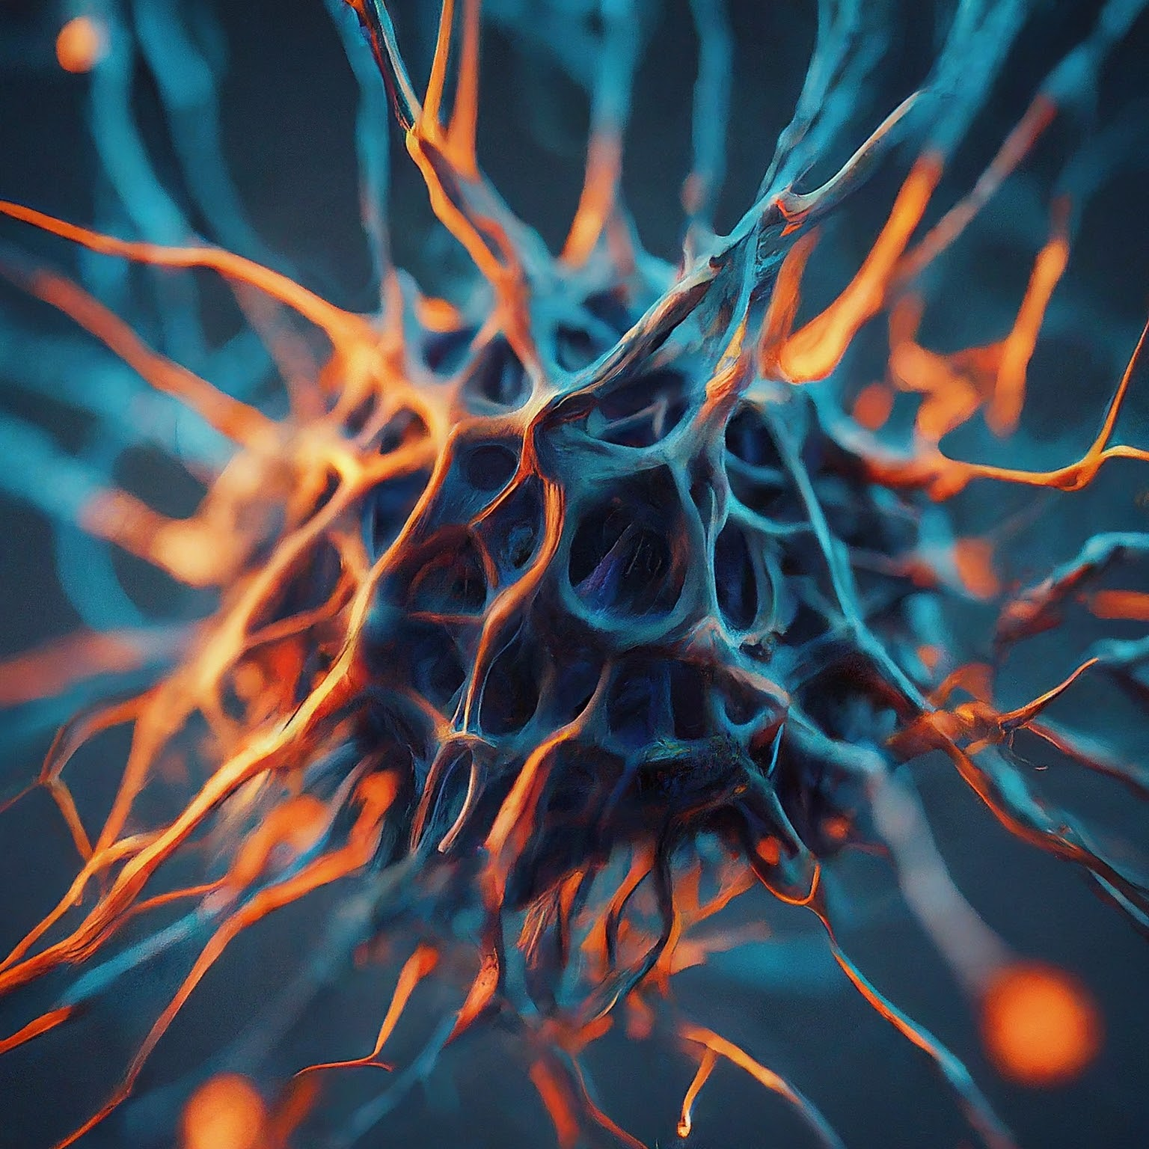
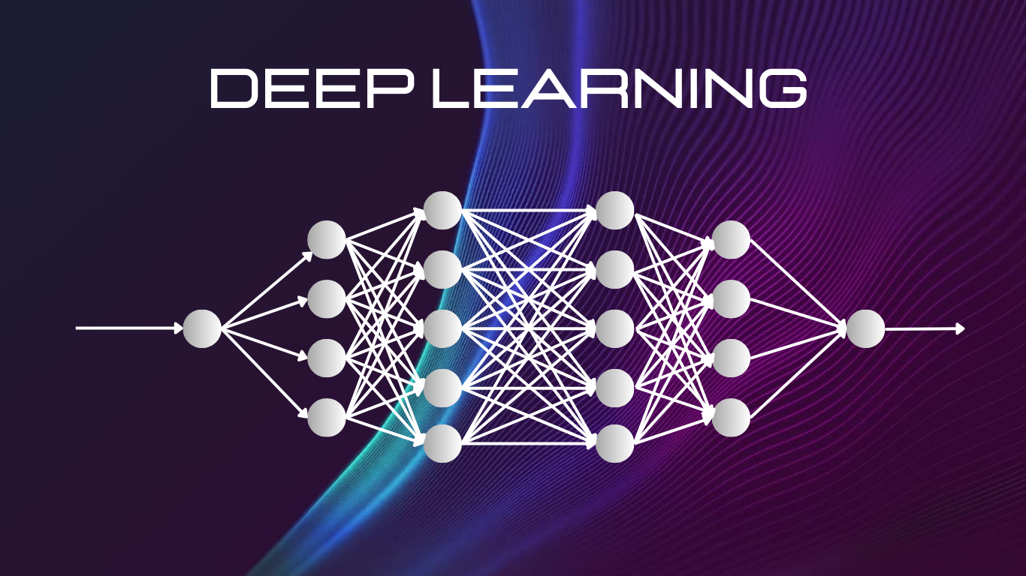
The Power of Deep Learning
Deep Learning: A subfield of Artificial Intelligence
Mimics the structure and function of the human brain
Learns complex patterns from large amounts of data
Deep Learning models excel at tasks like image recognition and natural language processing.
Deep Learning is a powerful tool that has revolutionized many fields, including speech enhancement. Deep Learning models are inspired by the structure and function of the human brain. They consist of artificial neurons arranged in interconnected layers. By processing vast amounts of data, these models can learn complex patterns and relationships. This ability makes Deep Learning ideal for tasks like image recognition, where the model learns to identify objects in pictures, and natural language processing, where it understands the meaning behind words.

Slide 23
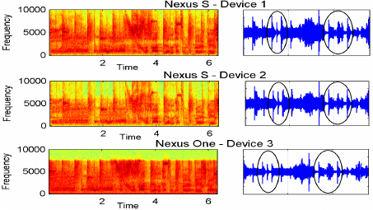
Deep Learning for Speech Enhancement
Deep Learning models can "learn" to remove noise from speech
Analyze spectrograms (visual representations of speech) to identify
noise patterns
Suppress noise while preserving clean speech
Various Deep Learning architectures are used:
Convolutional Neural Networks (CNNs) for feature extraction
Recurrent Neural Networks (RNNs) for capturing temporal dependencies
Generative Adversarial Networks (GANs) for generating clean speech from noisy input
Deep Learning can be harnessed for speech enhancement. By training on large datasets of noisy and clean speech pairs, these models learn to distinguish between speech and noise. They can analyze spectrograms, which are visual representations of the speech signal, to identify noise patterns. The model then selectively removes the noise while preserving the clean speech components. There are various Deep Learning architectures used for speech enhancement, each with its strengths. Convolutional Neural Networks (CNNs) excel at extracting local features from the speech signal, helping to identify noise patterns. Recurrent Neural Networks (RNNs) are adept at capturing the temporal dependencies in speech, allowing them to analyze how noise evolves over time. Generative Adversarial Networks (GANs) employ a competitive approach where two models work against each other. One model generates clean speech from noisy input, while the other attempts to distinguish between real and generated clean speech. This competition drives continuous improvement in the generated clean speech.

Slide 24
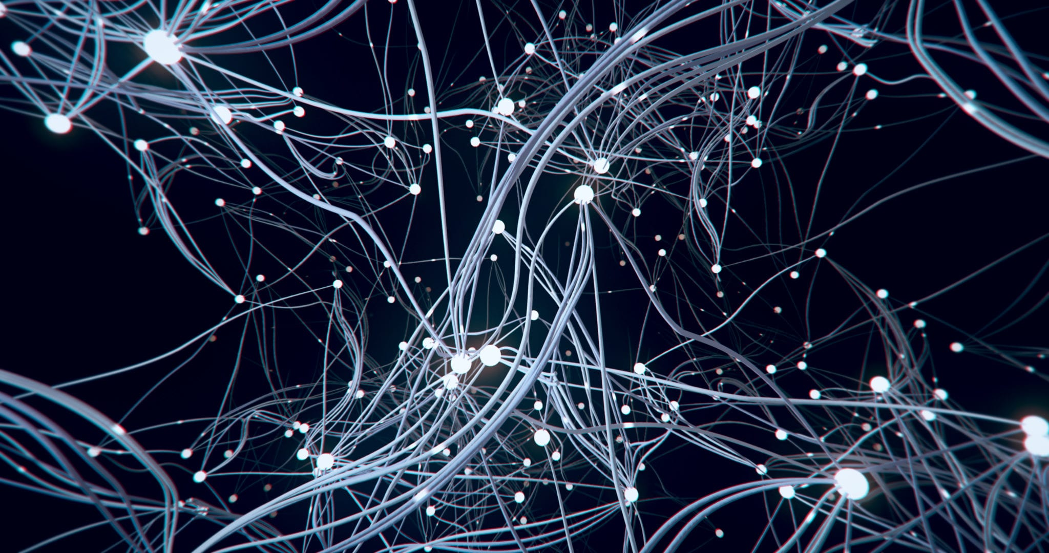
The Future of Speech Enhancement
Deep Learning holds immense potential for speech enhancement
Applications in various fields:
Improved communication in noisy environments (e.g., hands-free calling)
Enhanced hearing aids
Noise reduction in video conferencing
Transcription of historical audio recordings
Deep Learning is rapidly transforming the field of speech enhancement. As research progresses, we can expect even more sophisticated and effective models. This technology has the potential to revolutionize how we communicate in noisy environments. Imagine being able to have clear conversations on a busy street corner or holding a productive video conference in a bustling office. Deep Learning can also empower hearing aids by removing background noise and improving speech intelligibility for people with hearing loss. Furthermore, Deep Learning models can be used to enhance the transcription of historical audio recordings, allowing us to better understand

Slide 25
Algorithms

Slide 26
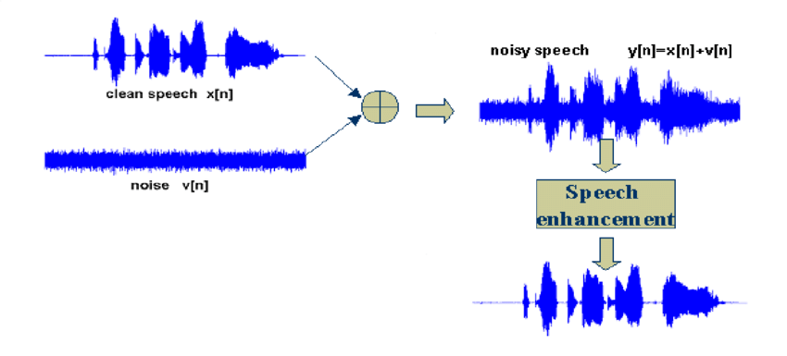
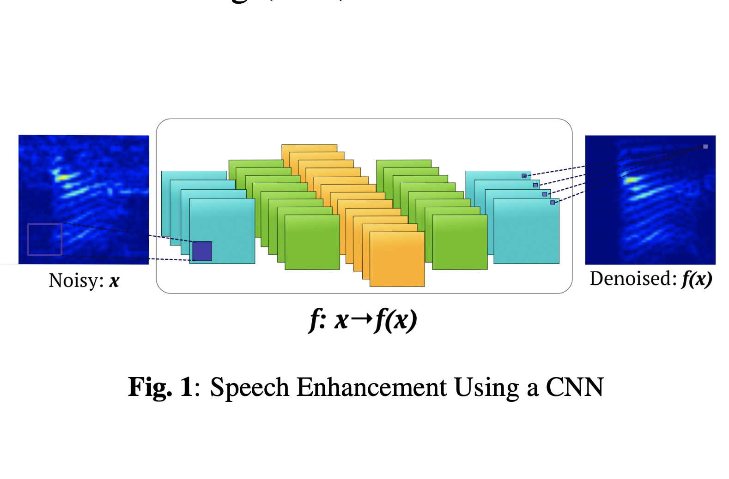
Algorithms
The choice of algorithm for speech enhancement depends on the specific requirements of the task, the characteristics of the input data, and the available computational resources.
it's important to consider factors like the input representation (e.g., raw waveform, spectrogram), the network architecture, the training data and loss functions, and the evaluation metrics.
Careful design and optimization of the model can lead to significant improvements in speech enhancement performance.
Often, a combination of these techniques, such as CNN-LSTM or hybrid models, can achieve state-of-the-art performance in speech enhancement.

Slide 27
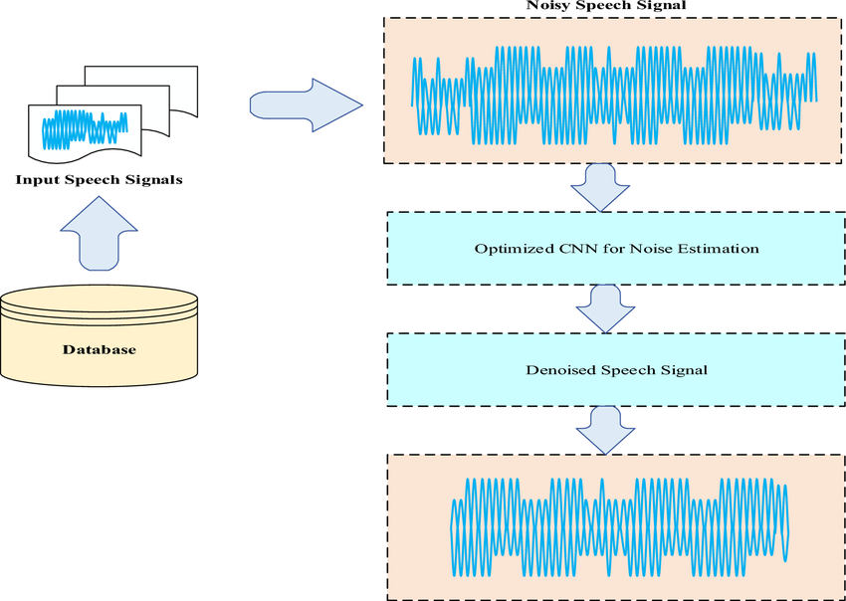
Algorithms
1- Convolutional Neural Networks (CNNs):
CNNs are a type of neural network that is particularly effective at processing grid-like data, such as images and spectrograms.
In speech enhancement, CNNs can be used to capture local features and patterns in the time-frequency representation of speech signals.
CNNs can efficiently extract relevant features from the input spectrogram and perform noise reduction.
Combining CNNs with RNNs (e.g., CNN-LSTM) can further improve speech enhancement performance by leveraging both spatial and temporal information.

Slide 28
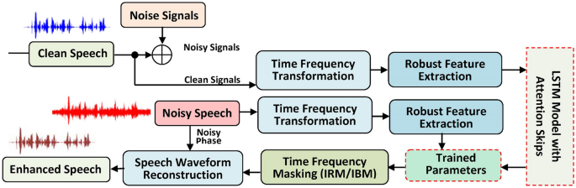
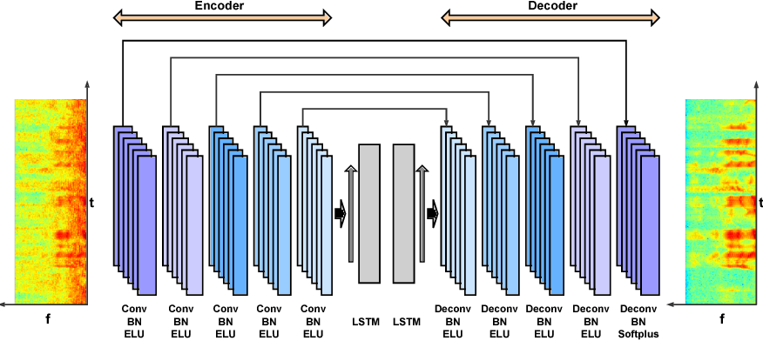
Algorithms
2- Long Short-Term Memory (LSTM):
LSTM is a specific type of RNN that is designed to overcome the vanishing gradient problem, allowing it to learn long-term dependencies in the data.
In speech enhancement, LSTM models can effectively capture the temporal dynamics of speech and noise, leading to improved noise reduction and speech quality.
LSTM-based models can be used in various speech enhancement tasks, such as speech denoising, speech separation, and speech dereverberation.

Slide 29
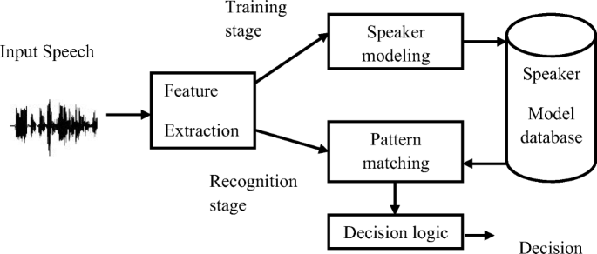
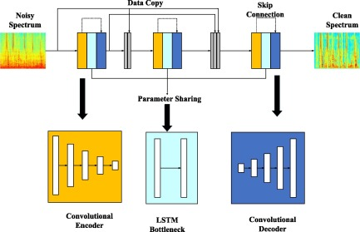
Algorithms
3- Recurrent Neural Networks (RNNs):
RNNs are a type of neural network designed to handle sequential data, such as speech signals.
RNNs use feedback connections to remember previous inputs and incorporate them into the current output.
In speech enhancement, RNNs can be used to model the temporal dependencies in speech signals and improve noise reduction.
Common RNN architectures used for speech enhancement include Long Short-Term Memory (LSTM)

Slide 30
Implementation , Results and Discussion

Slide 31
Implementation
We started by importing Libraries such as : import Ipython, import matplotlib.pyplot as plt, import numpy as np, import psutil , import torch, import torch.nn as nn .
We will use combinations of the noise and voice samples in the train subfolders to perform the training part, and combinations taken from the test subfolders for the evaluation part.
the current directory two folders: noise and voice, each of them containing two subfolders train and test.
defines two functions, `train` and `test`, for training and testing a machine learning model, respectively.
The `train` function takes a dataloader, a model, a loss function, an optimizer, and an optional boolean flag for printing the loss.
It iterates through the batches of data in the dataloader, computes the prediction, calculates the loss, performs backpropagation to update the model parameters, and optionally prints the current loss.
The function returns the final loss value.

Slide 32
Implementation
The `test` function takes a dataloader, a model, a loss function, and a PESQ (Perceptual Evaluation of Speech Quality) function.
It evaluates the model on the test data, computes the average test loss and PESQ error, and prints the results. The function returns the test loss and PESQ error.
We used a Function Called compare_batch() that takes three arguments: x, y, and pred.
it used to evaluate the performance of a speech enhancement model by computing and comparing the PESQ and STOI metrics between the input signal, the target signal, and the predicted/denoised signal.
We also used one_to_n_dataset that takes in voice_samples, noise_samples, n_noise_per_voice, and an optional noise_factor parameter.
The function is designed to create a training and test dataset for a machine learning task involving audio signals.

Slide 33
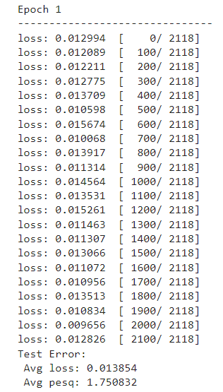
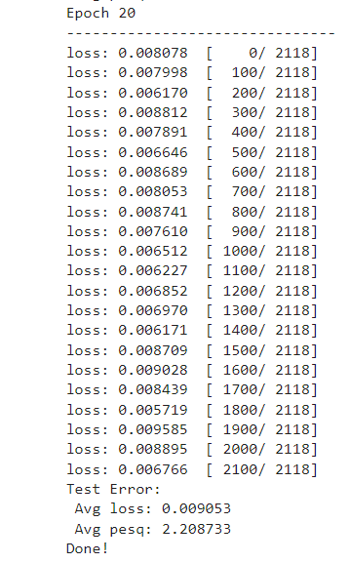
Results and Discussing
In Our Code We Used 20 Epochs , We Take Results From The First Epoch And The Last Epoch.
Avg Loss: 0.013854 Avg Loss: 0.009053 Avg PESQ: 1.750832 Avg PESQ: 2.208733

Slide 34
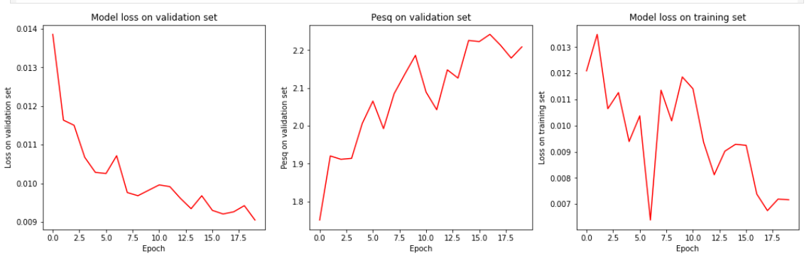
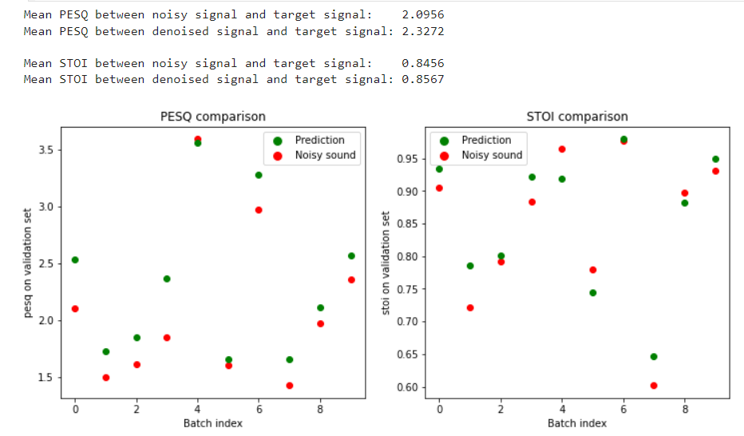
Results and Discussing
For The Model Loss on Validation set , PSEQ on Validation Set and Model Loss on Training Set.
For the Mean PESQ Of the Target Signal : 2.0956 , 2.3272

Slide 35
Conclusion & Future Works

Slide 36
Conculusion
Mean PESQ between noisy signal and target signal: 2.0956
Mean PESQ between denoised signal and target signal: 2.3272
PESQ For The LSTM is : 0.4
*Increase Accuracy*: Implement advanced algorithms and refine our models.-
*Reduce Errors*: Enhance error-checking mechanisms and optimize code.
*Current Results:*- Achieved the best possible results with current methods and resources.
*Conclusion:*- Our project demonstrates significant progress in coding techniques.- With future improvements, we expect even better performance and reliability.

Slide 37
Future works
Sound Enhancement:
Sound enhancement refers to the process of improving the quality and clarity of audio signals. This can involve various techniques such as:
Noise Reduction
Equalization
Dynamic Range Compression
Stereo Widening
Room Correction

Slide 38
Future works
Video Enhancement:
Video enhancement focuses on improving the visual quality and clarity of video content.
Some common techniques include:
Resolution Upscaling: Increasing the spatial resolution of the video, making it appear sharper and more detailed.
Noise Reduction: Removing or reducing unwanted visual noise, grain, or artifacts to improve the overall image quality.
Color Correction: Adjusting the color balance, saturation, and contrast to enhance the visual appeal and accuracy.
Sharpening: Applying edge-enhancement algorithms to make the video appear crisper and more defined.
Frame Rate Interpolation: Generating additional intermediate frames to create a smoother and more fluid motion.

Slide 39
References

Slide 40
References
https://github.com/vbelz/Speech-enhancement
https://github.com/aubin-tchoi/audio-speech-denoising/blob/main/audio_speech_denoising.ipynb
-https://towardsdatascience.com/speech-enhancement-with-deep-learning-36a1991d3d8d
-https://www.divaportal.org/smash/get/diva2:1355369/
FULLTEXT01.pdf
-https://www.jurnalet.com/jet/article/view/392

Slide 41

Thank You...

